Slide 1
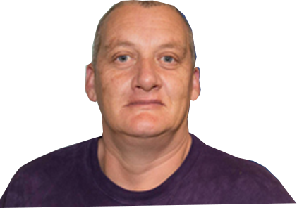
Welcome
Today we are going
to talk about RIGHTS!!!
So let’s get started . . .

Slide 2
We all have rights!!!
But often people with a disability don’t
get to use their rights.
Self advocacy groups speak up for the rights of people with a disability.
Notes:
Explain: This section is about your rights

Slide 3
We are going to talk about :
Human Rights and Disability Rights
Notes:
Explain: We will be talking about human rights and the rights of people with a disability.

Slide 4
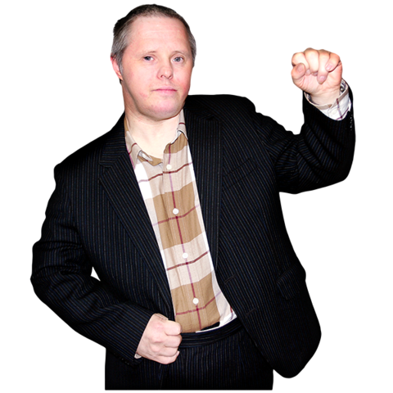
Human Rights
What do you know about
your rights?
What rights do you have?
What rights do you think
people with disabilities
don’t get?
Notes:
Discussion: Guided discussion on rights.

Slide 5
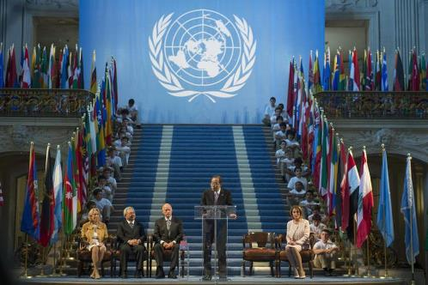
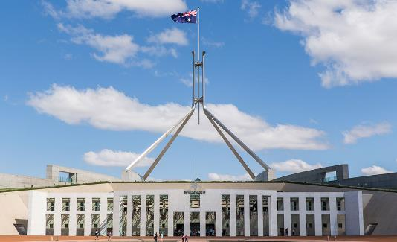
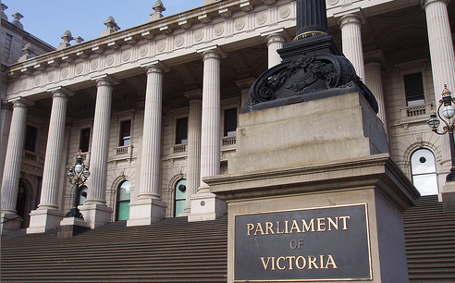
Where Do Human Rights Come From?
Australia has laws and rules about your rights. They come from the:
United Nations Australian Government
State and Territory Human Rights Commission
Governments
Notes:
Explain: Rights come from many places from the United Nations, the Australian Government, and state and territory governments and the Australian Human Rights Commission. Explain these concepts if needed.

Slide 6
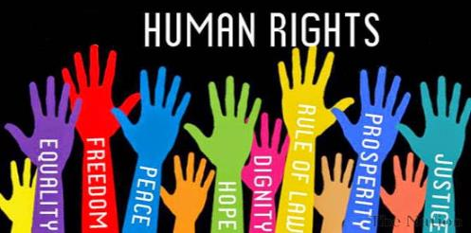
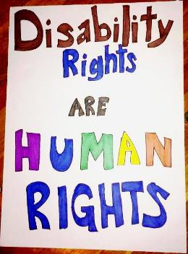
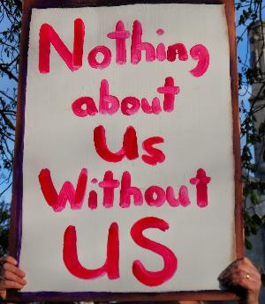
What are your rights? Pick a card . . . .
Let’s play!!!!!
Pick a card. Read out the ‘Right’ on
the card and discuss . . .
Notes:
Activity: This activity introduces the concept of the need to get information to help make decisions. Ask people pick a card and read out the card and then support a guided discuss about the right described on the card – what it is about, is it important?, why it is important etc.

Slide 7
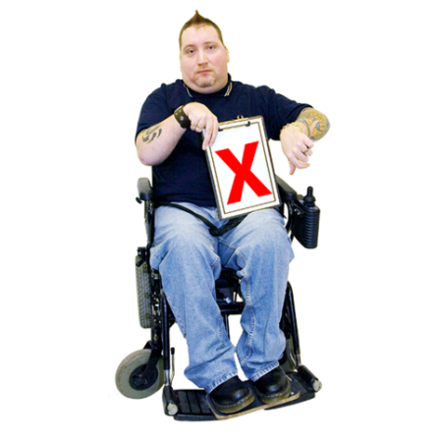
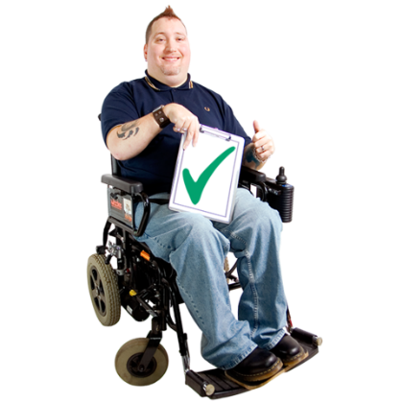
Human Rights
Can you think of times when
you didn’t get to use your rights?
Are there times when you
did get your rights?
Notes:
Discussion: Support a guided discussion about when people have felt they did or did not have their rights upheld or respected

Slide 8
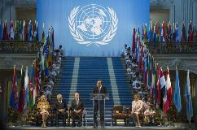
United Nations Convention on the Rights
of Persons with a Disability (UNCRPD)
Let’s watch this video to learn more about the UN convention!!!!!!
Notes:
Concept: This section introduces the UNCRPD explain that from now on you will call it the convention – explain that countries all over the world signed the convention which outlines universal rights for people with disabilities. Play the video and discuss.

Slide 9
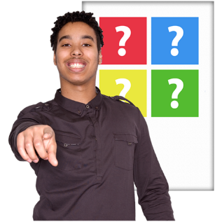
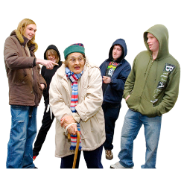
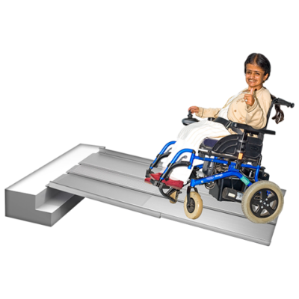
United Nations Convention on the Rights
of Persons with a Disability (UNCRPD)
The United Nations says that people with disabilities living all over the world have rights. These are called “Articles.” They say you have the right to:
Make your own choices
Not be treated differently
or discriminated against
Be fully included in the community
Live in good housing
Work in good jobs
Access transportation
and buildings
Notes:
Recap: Remind the group that Australia signed up to the Convention which means they have agreed to support rights or articles as described in the Convention.

Slide 10
So . . . ?
The UN and Australian laws say you have the right to:
Be treated equally and fairly
Not be discriminated against
Be treated with respect
Be free, and go wherever you want
Keep your life private
Join groups or unions
Say what you want
Notes:
Recap: Recap the rights and the laws outlined in the previous slides – support discussion if people are interested

Slide 11
If you are not getting your rights, contact . . .
The Australian Human Rights Commission
Telephone: (02) 9284 9600 National Information Service: 1300 656 419 General enquiries: 1300 369 711
Notes:
Explain: That the Australian Human Rights Commission can provide you with information about your rights.

